Slide 1
Submitted To: Manish Sharma (ibm trainer) Submitted By: Ayan Bhatnagar (Leader) Kartikey Garg Yash Sharma Pradyumn Bahukhandi
IBM G-10

Slide 2

Analysis and Prediction of effect of viral diseases in Human + deployment
Group 10

Slide 3
Work-flow
Know the Reason
To specify the flashing side of project
1
Collecting
The 1st process towards our project is to collect the data from online sources. Data preparation by transforming and cleaning we will do here.
2
Understanding
Now to visualize this data. And understanding the flow of diseases in human
3
Prediction
Figuring out how one can get advantage of this with certain constrains.
4
Deployment
At the end building a platform where it is easy for user and data to communicate easily.
5

Slide 4
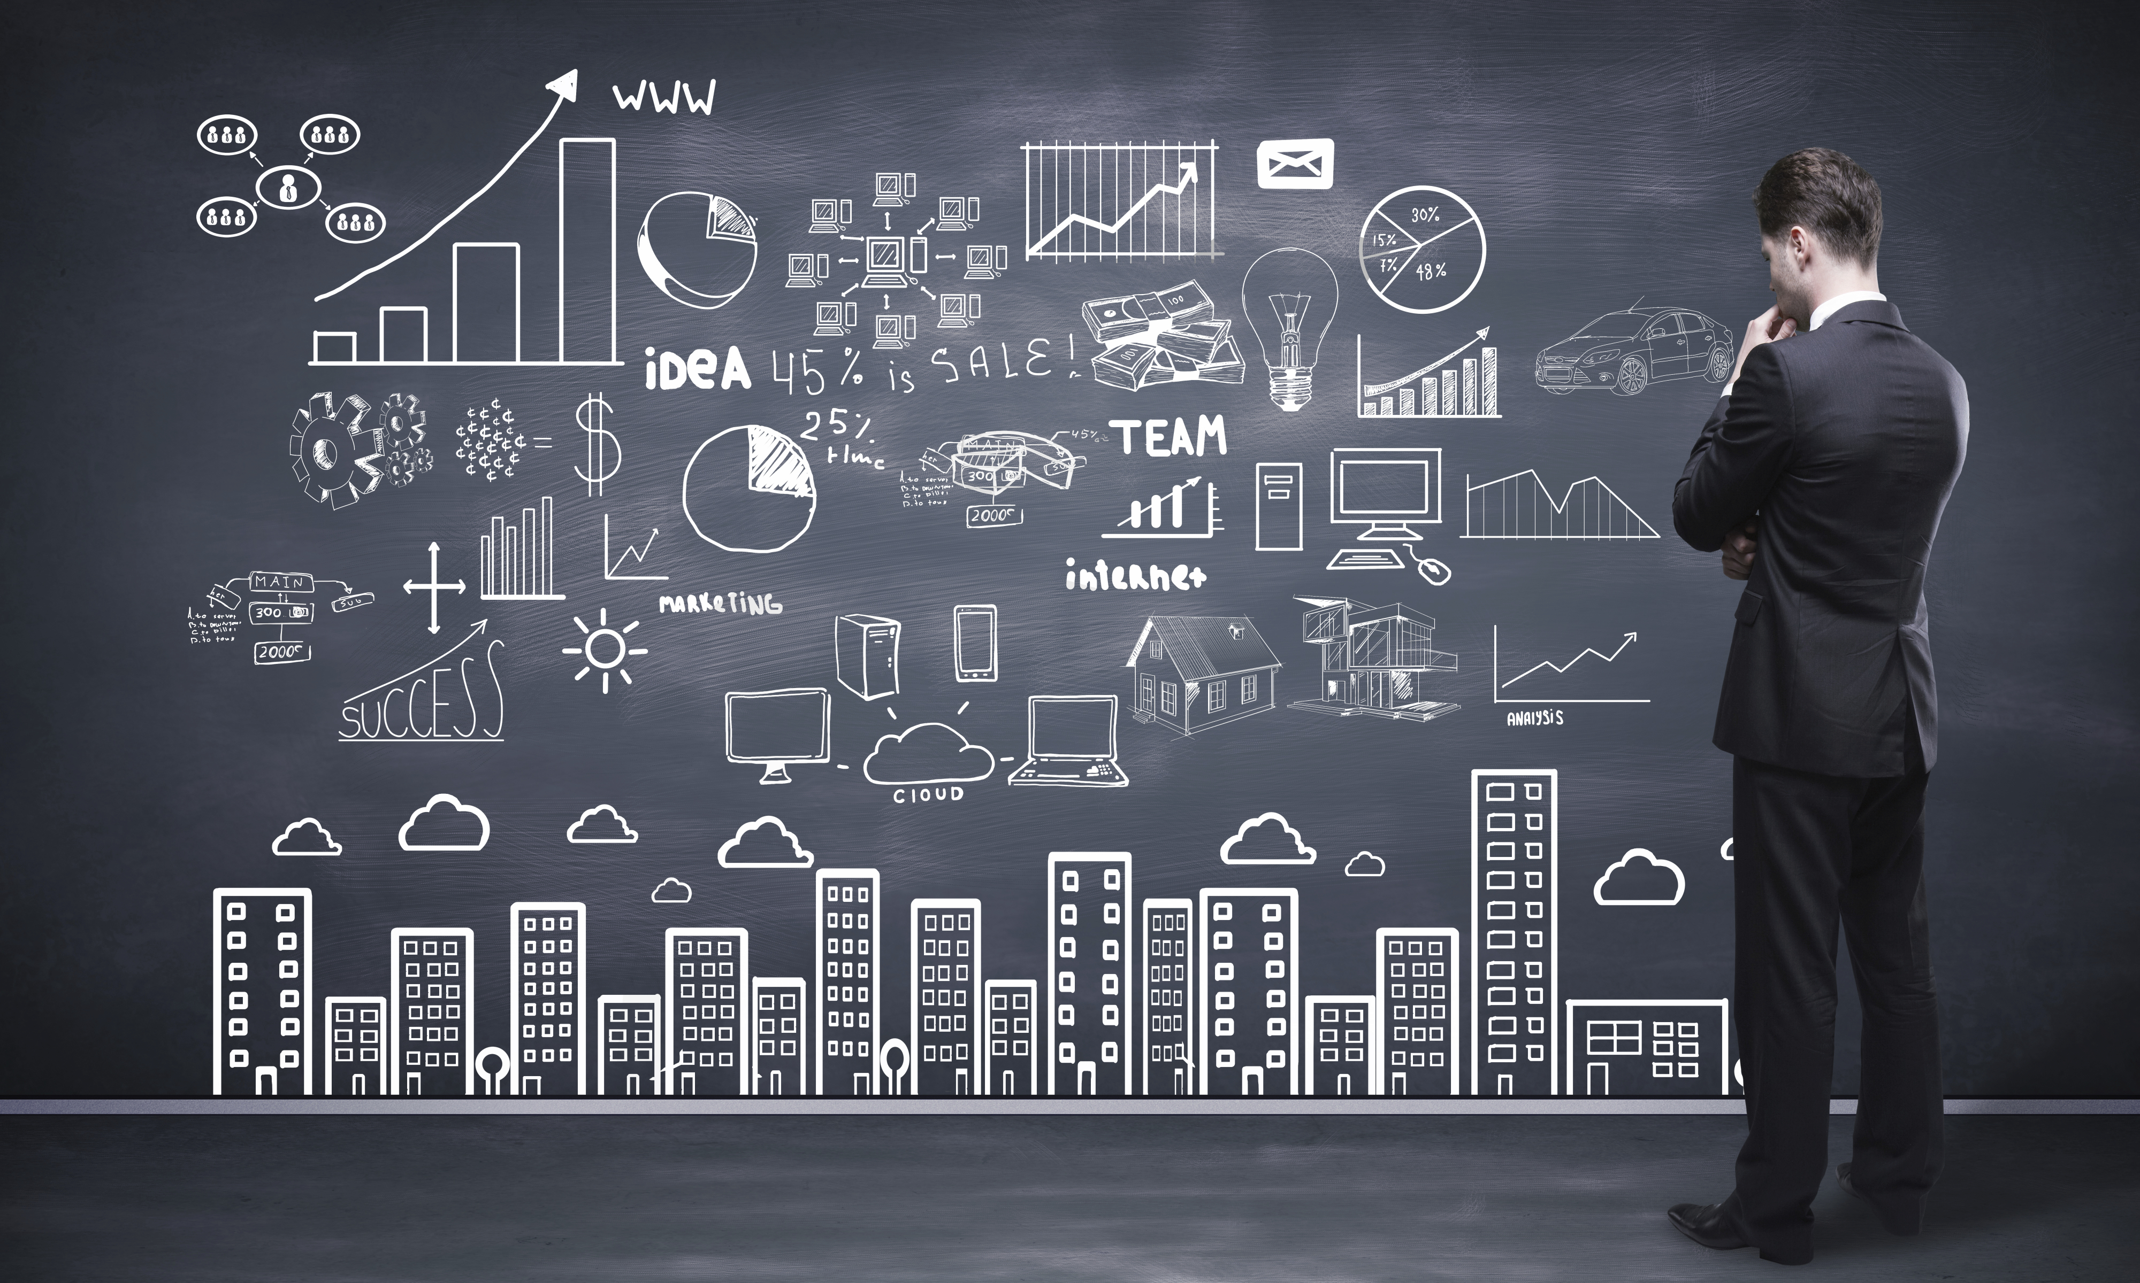
Know the reason
Analysis on this dataset can help us to understand human symptoms.
It helps us figuring out the future scope of viral diseases and their symptoms too.
Not only this for an accuracy of 80% this limit bounded analysis can be helpful for the further future researches where in they would have future prospects like AI in health and neurology.

Slide 5
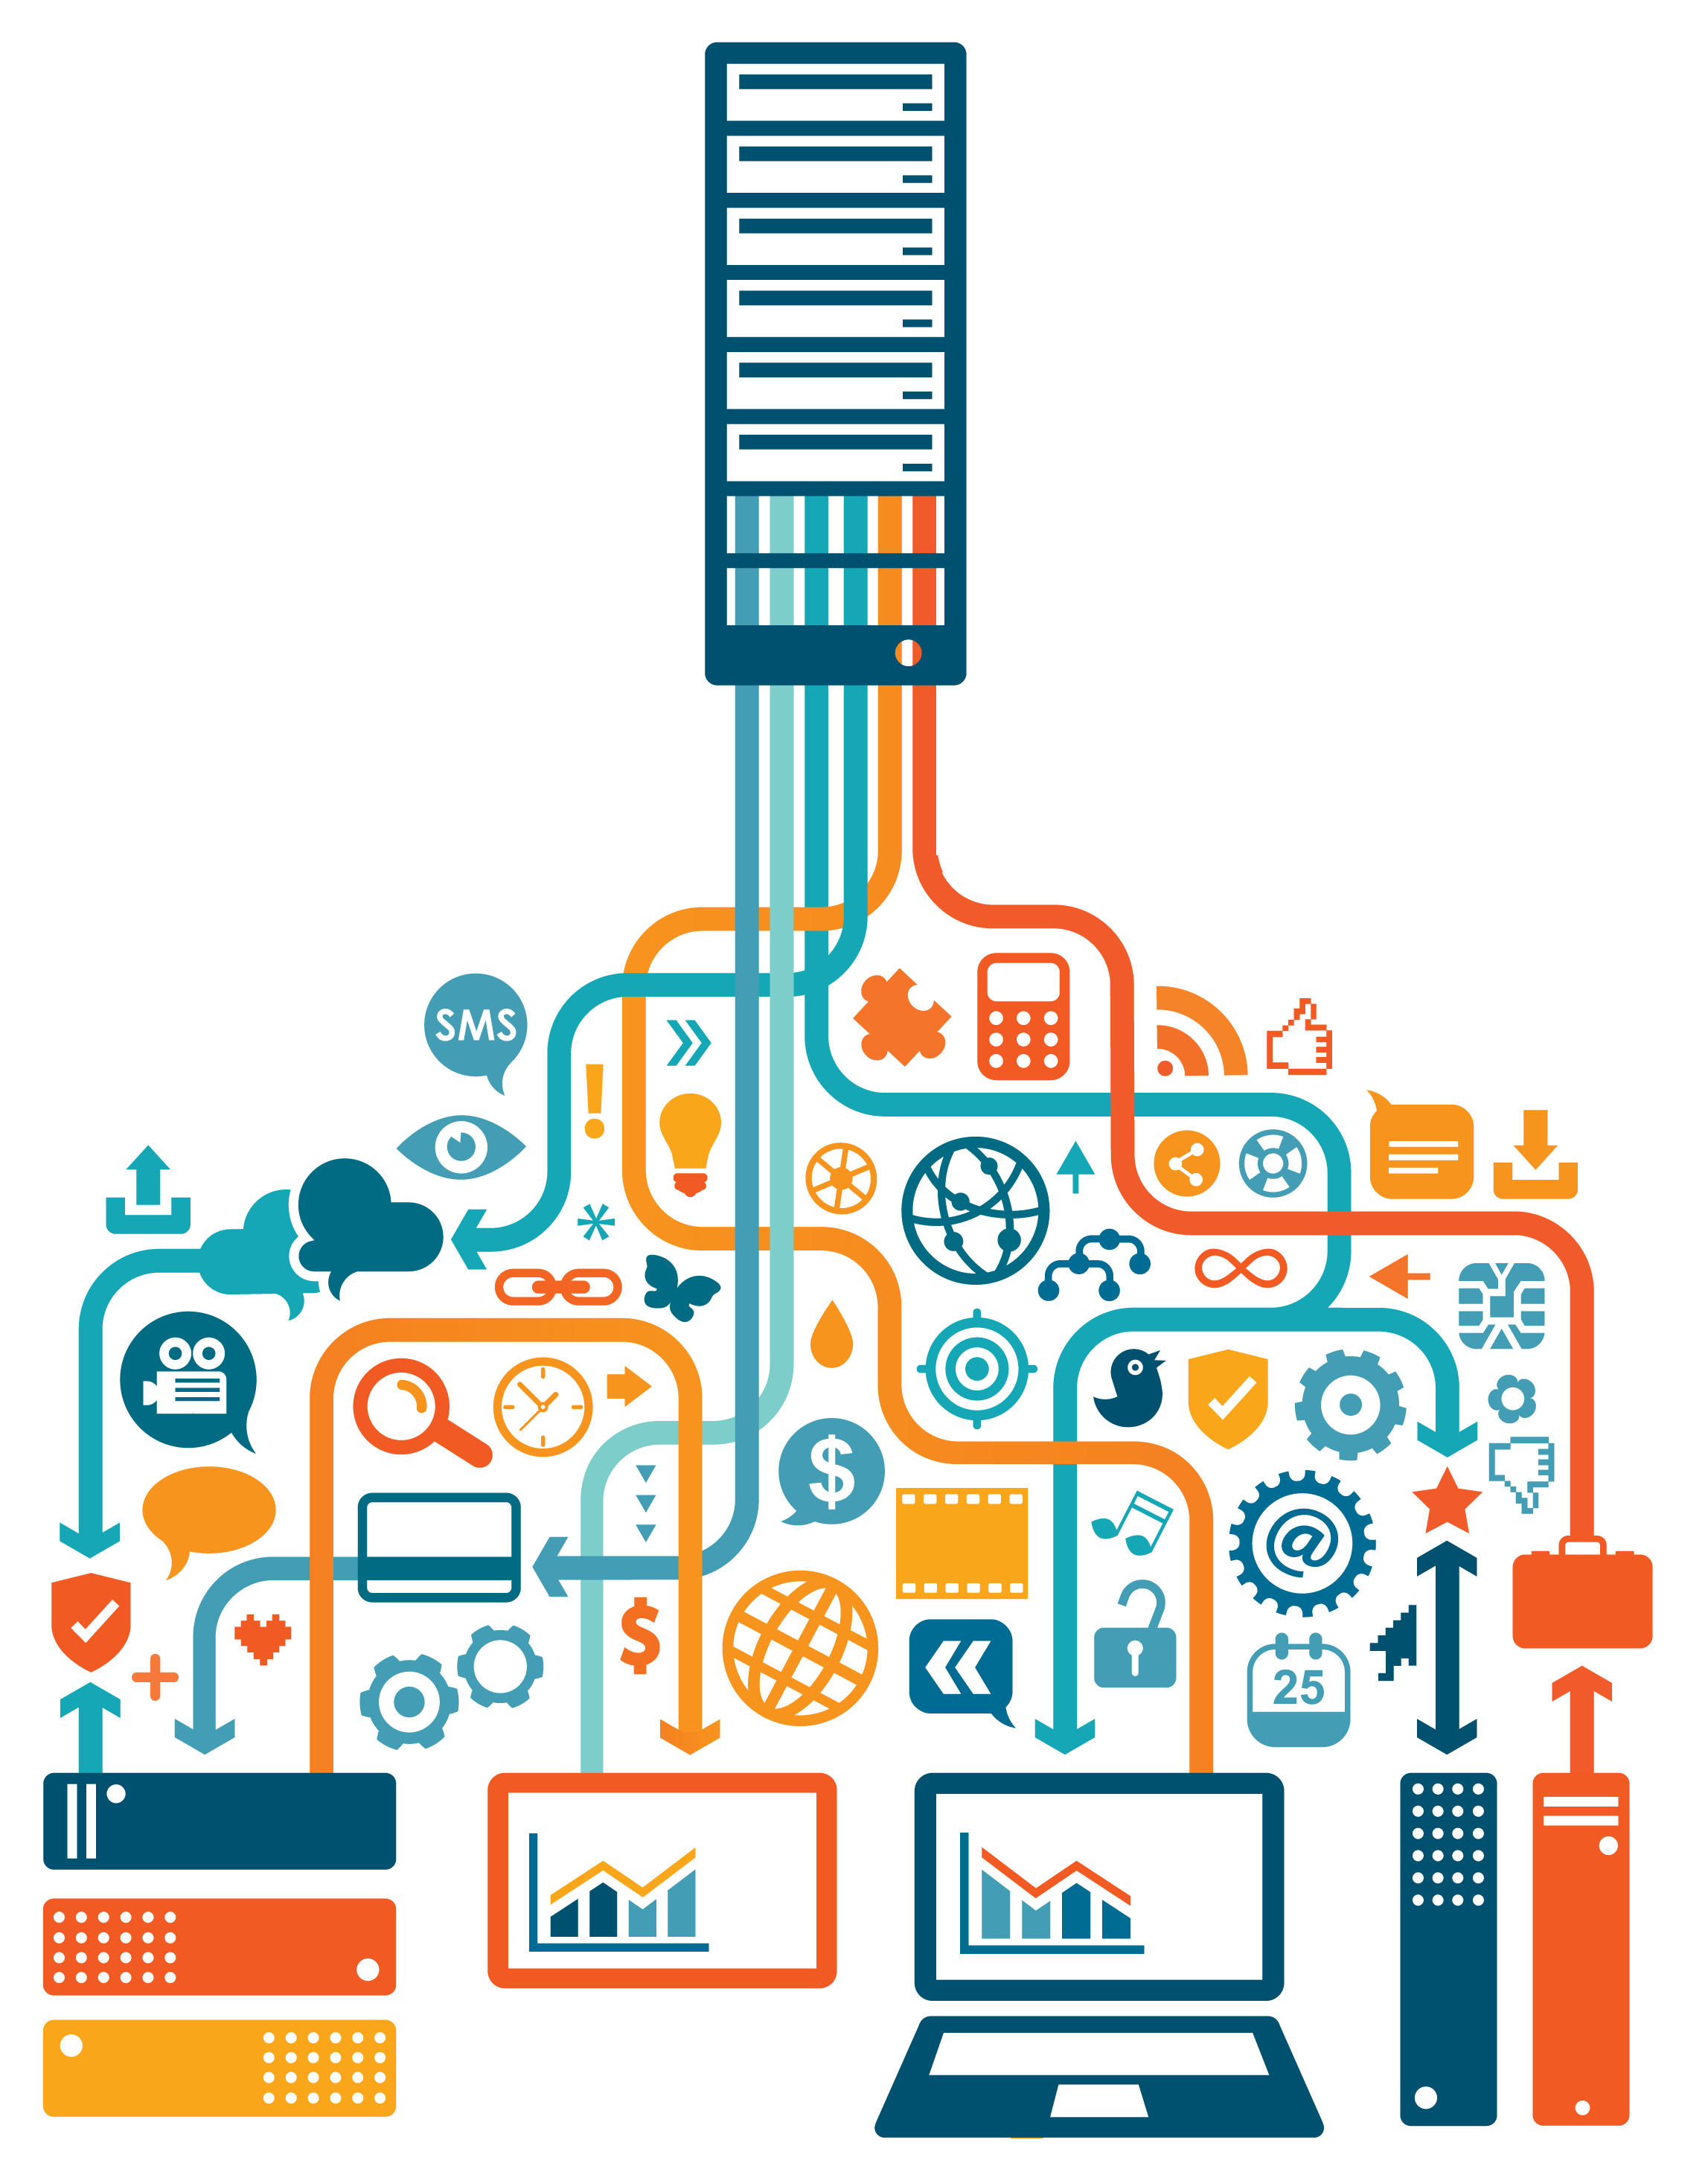
Collecting
We have reached to our dataset long after browsing through web:
The data we have collected are in format of xlsx, csv.
We have gathered our data form sources like CERN, Kaggle, UNICEF, Data World etc.
The data that we have collected is very incompatible to our systems
So our next step is to prepare it for our understanding.
The datasets we have till date are of :
COVID , Dengue , HIV-AIDS , Hanta Fever , Pneumonia , Ebola , Influenza , Zika Virus.

Slide 6
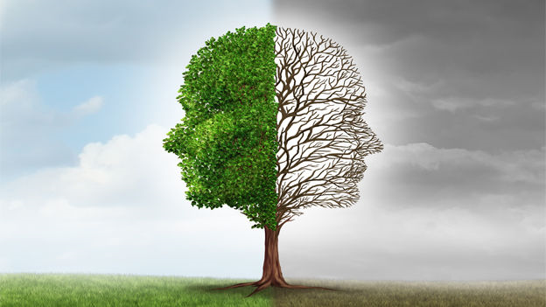
Data preparation
BUILDING FROM MEANING LESS TO MEANINGFUL
Since our data contain too many missing and null values so we have decided to filter out some of these values as well as filling some of them. For that
For that we are using some libraries and packages from python, R
Now we are ready to understand this data based on some constraints that are required for our analysis.

Slide 7
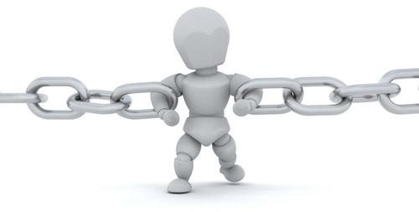
Constraints
At each visualization we will focus on the relationship between human and virus.
More specifically we will study the effect on human based on gender, age, time, intensity, place.
We will also look for symptoms reflected and their commonness.
We will neglect the analysis above and below a specified age.
We will relate the age with disease categorized by place.

Slide 8
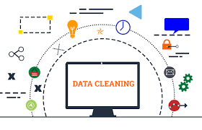
Methods and Materials
After collecting the datasets from various sources they include the data that is incorrect, incomplete, irrelevant, duplicated or formatted in different data type so this data is not helpful in terms of analyzing because it may provide incorrect results so in this current project phase, we check whether our dataset is cleaned or not. Most of our data sets are accurate and does not require cleaning of our data , if it is required, we will do data cleaning with the help of python using it's libraries in order to fill empty fields and to identify duplicate data types.
The procedures that we acquire in order to clean the datasets are shown in the slides below:

Slide 9
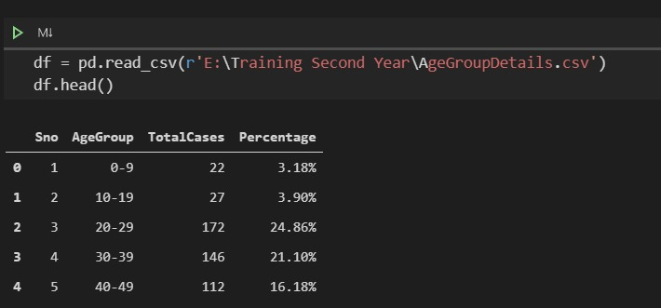
People of all age-group effected by covid-19

Slide 10
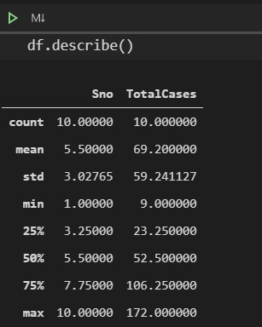
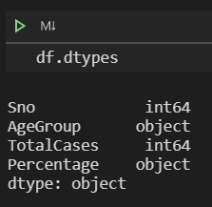
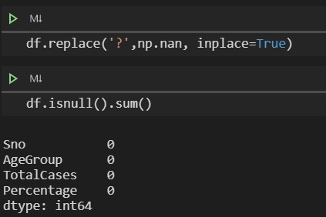
Total cases effecting the age-group

Slide 11
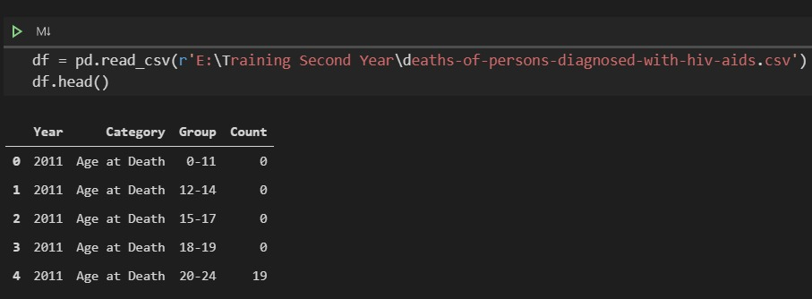
Deaths of person Diagnosed with hiv-aids

Slide 12
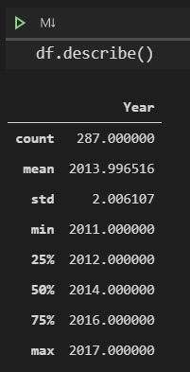
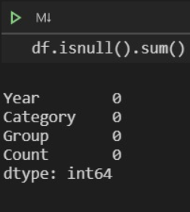
Average Death due to Hiv-Aids

Slide 13
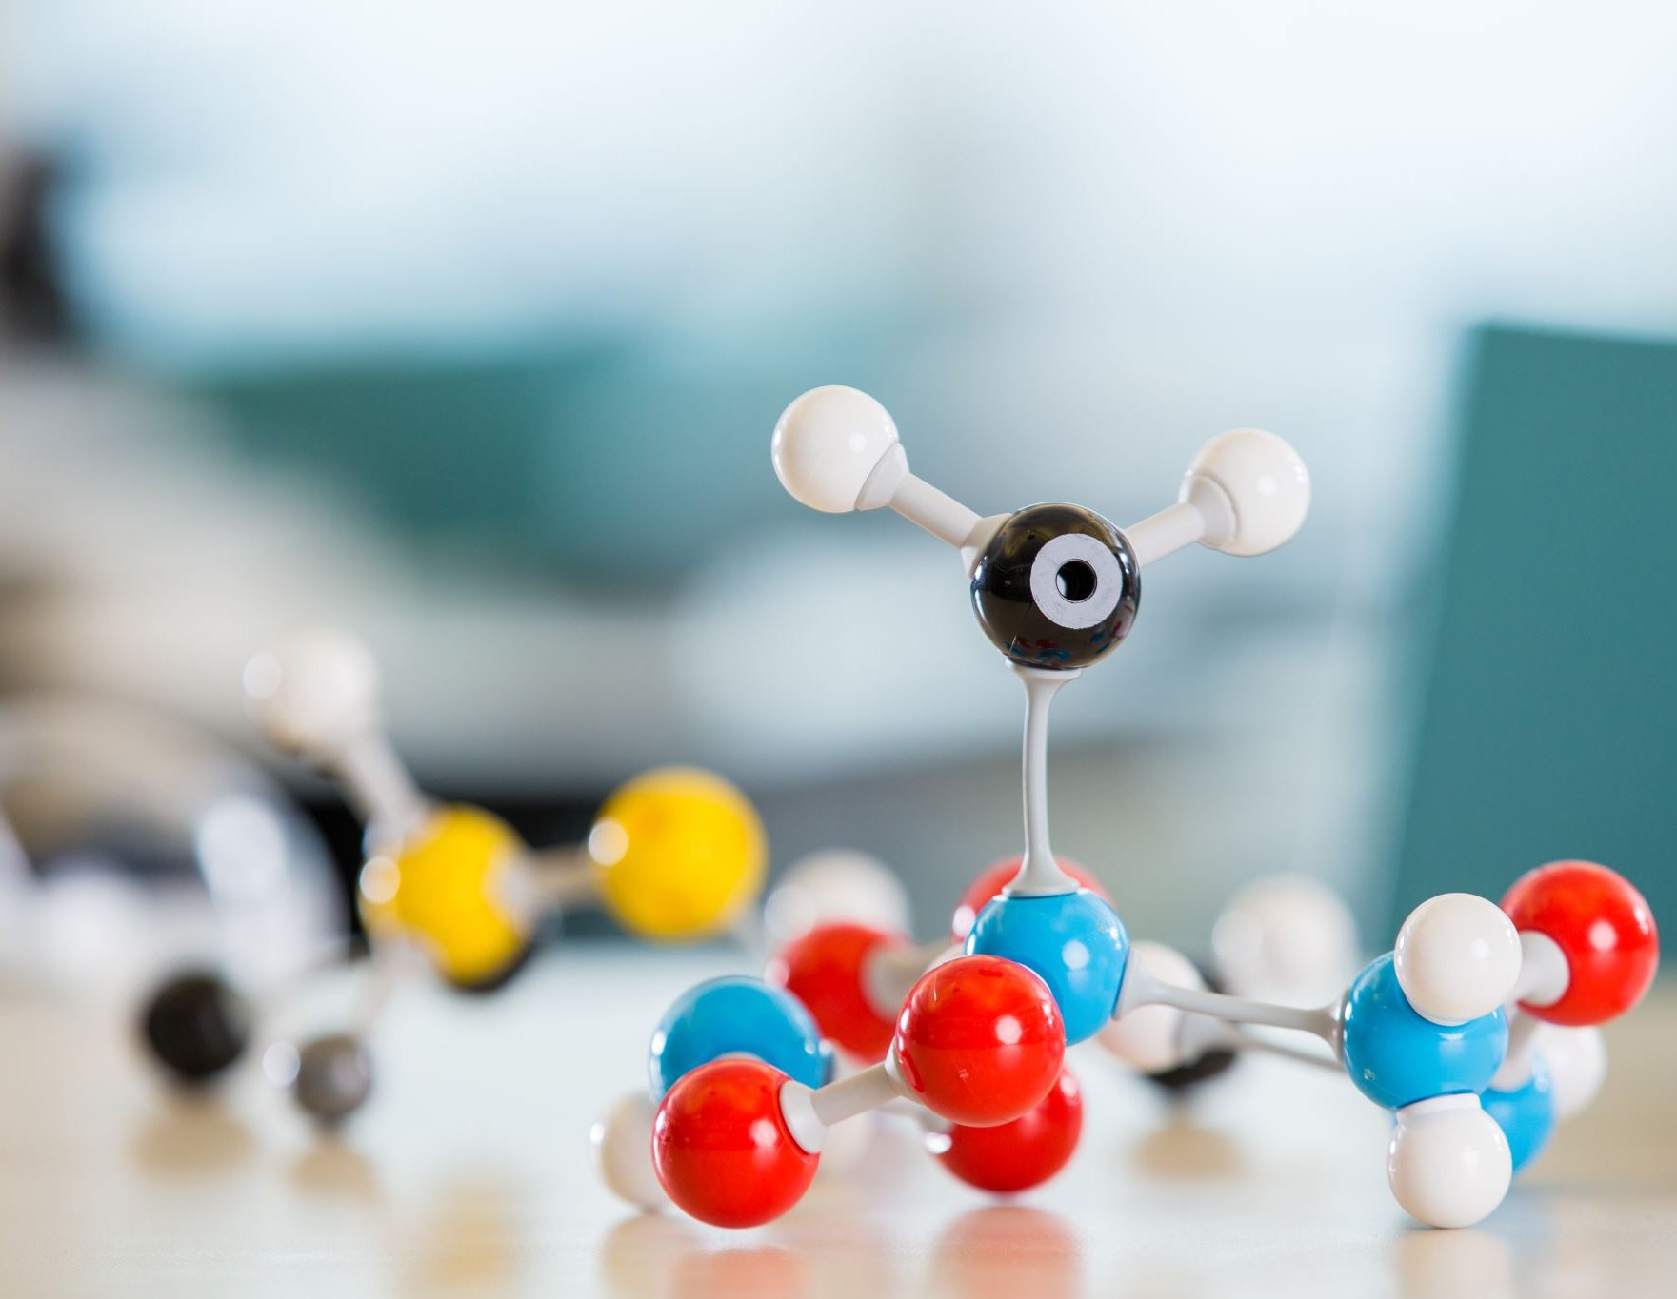
Prediction phase
Phase 2

Slide 14
Abstract
Filter Data Sets/API from Phase-1
Click to addext
Implementation of NumPy, Pandas & Matplotlib
Using Of IBM Cognos and orange For Analysis
Phase-3

Slide 15
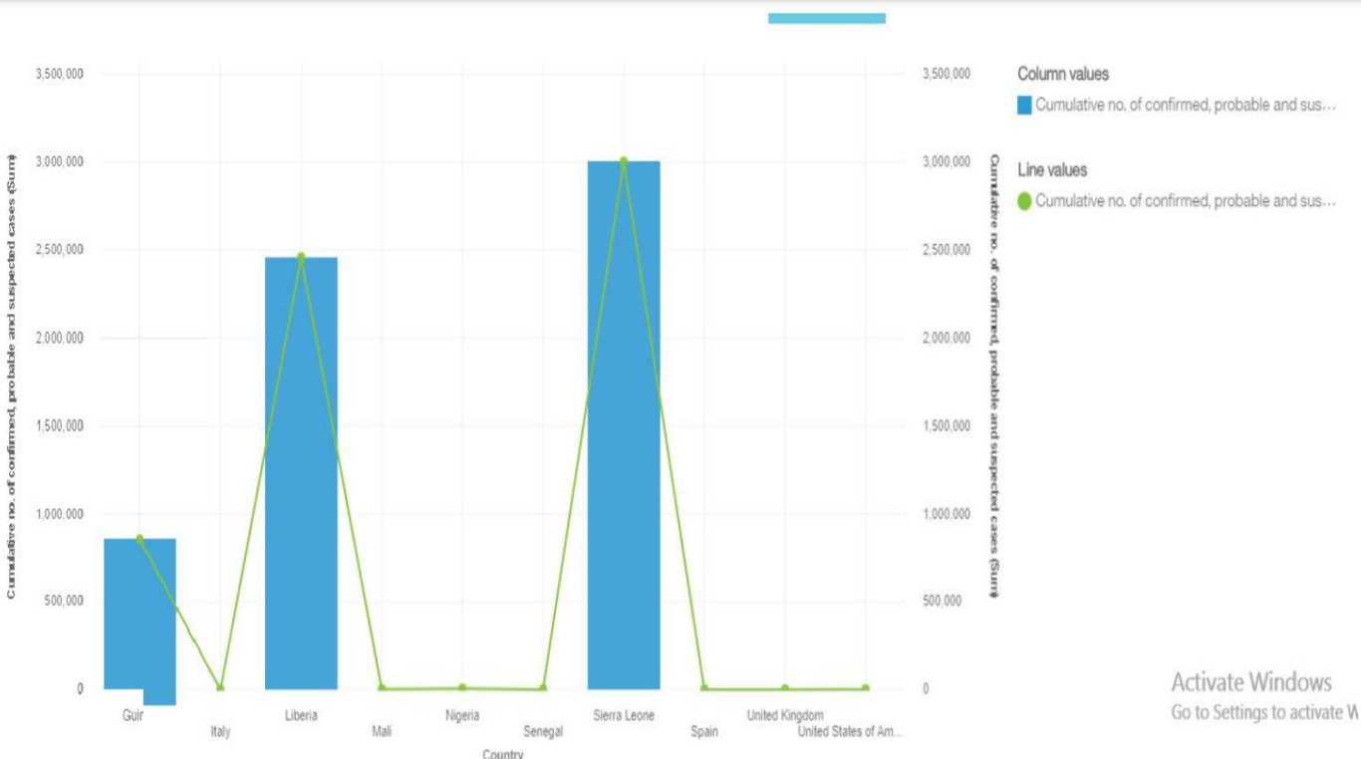
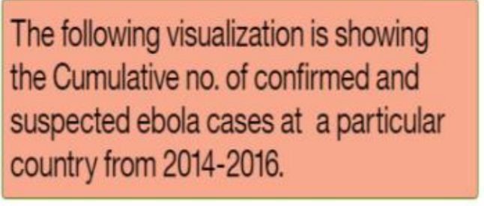
Research on Ebola Virus

Slide 16
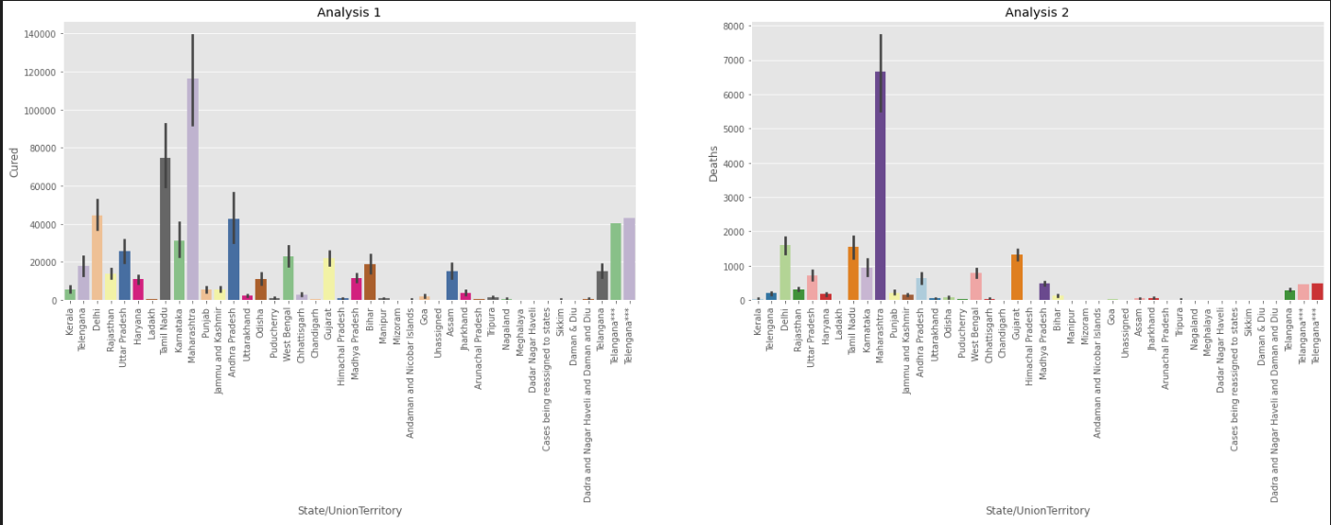
This analysis shows the correlation between the recovered/cured cases and the number of deaths in different states of India. As the number of cured cases increases, so does the number of deaths.

Slide 17
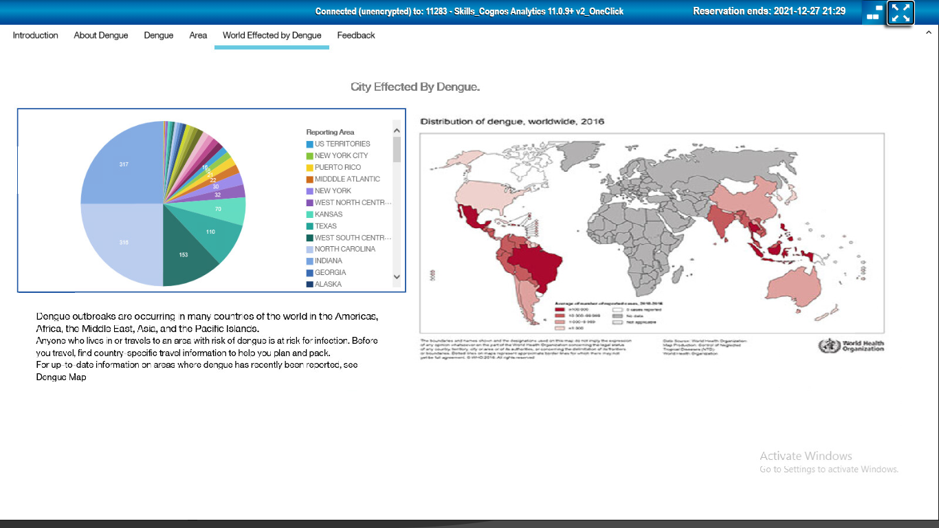

Slide 18
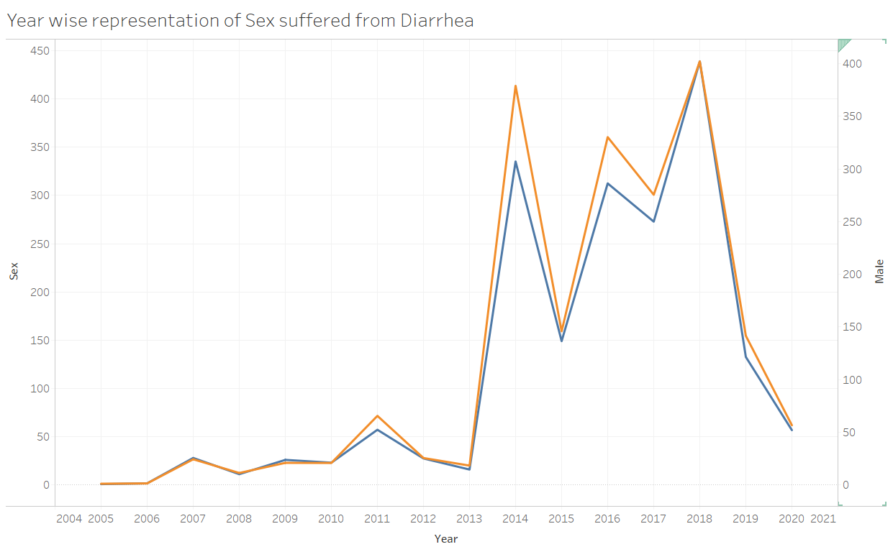
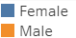


Representation of Comparative study between Males and females suffering from Diarrhoea.
The number of Cases increases Heavily in Year 2013-14, 2015-16 and 2017-18.
Conclusion: There’s not very large difference between the Ratio of Males and Females.
Notes:
Representation of count of males to the ratio of female cases suffering from Diarrhoea: they are Nearly Same. But we see that it increases heavily on 2013,2015,2017.

Slide 19
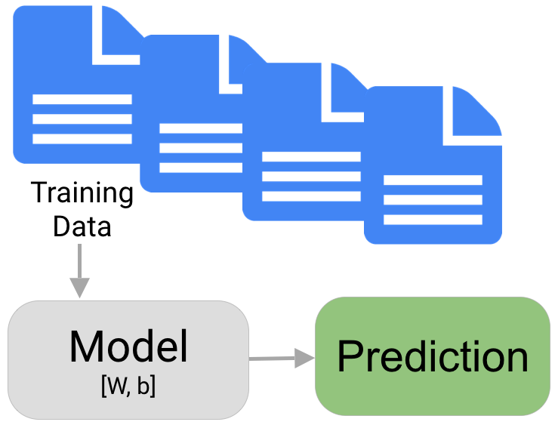
Predictions using datasets
A prediction is a statement about the future. It’s a guess, sometimes based on facts or evidence

Slide 20
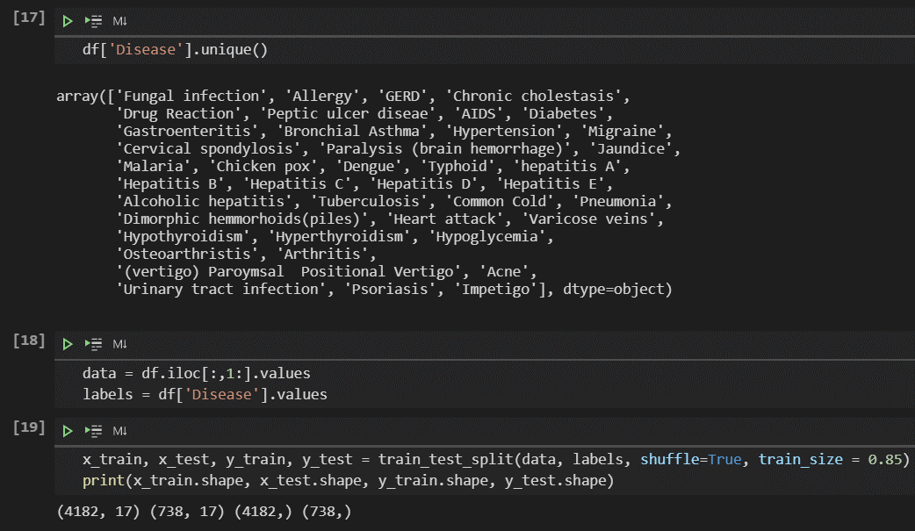
Getting started with Prediction
Getting an overview of number of diseases in dataset and accordingly assigning the disease names to labels for prediction.
Finally Splitting the data in the ratio of
(85 : 15)
(train : test)

Slide 21
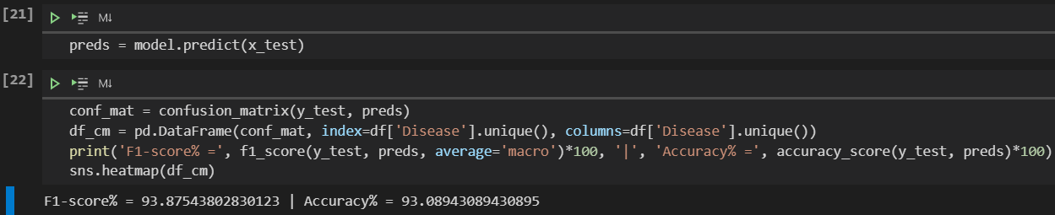
Model’s accuracy
Finally training model and predicting the Test set using SVC (Support Vector Classifier)
Our model’s accuracy comes out to be 93%.
To understand the balance between precision and recall we calculated F1 Score that turned out to be 93.8%. The Concludes that most of the Actual True Positive Values were predicted True Positive and Similarly for the other one.

Slide 22
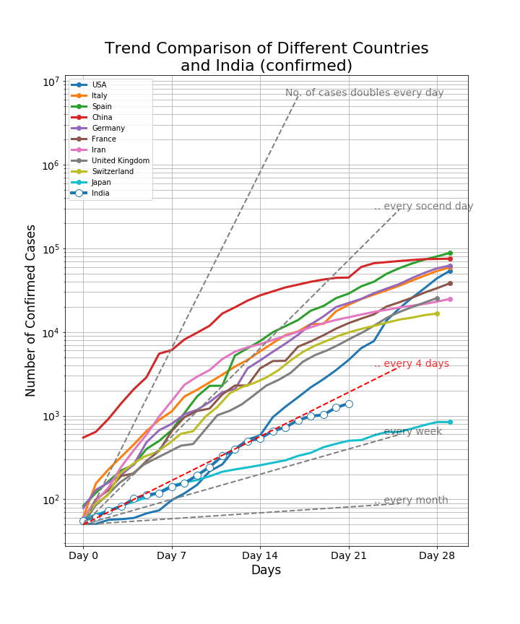
This graph here shows the relation of how the Confirmed cases were increasing in the few major countries on the Globe.

Slide 23
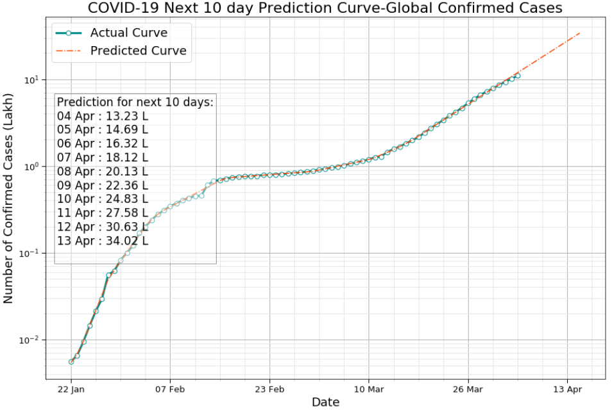
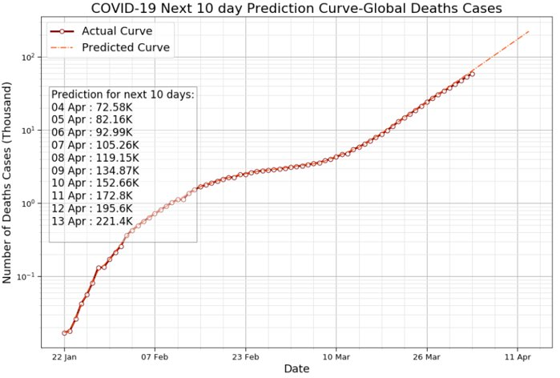
Prediction on Deaths and confirmed cases due to covid-19

Slide 24

Tools and technologies used for website designing
Phase-3

Slide 25
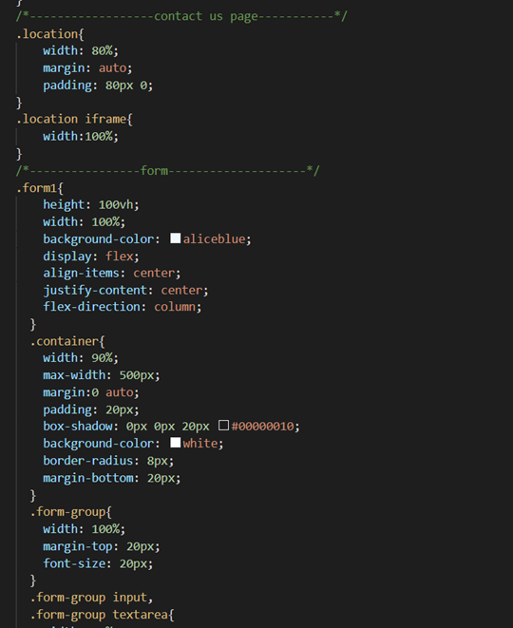
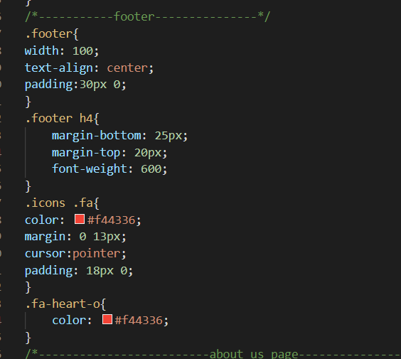


This is the part where we have styled different components of the form.
For designing the footer we have targeted different bootstrap icons and added different colours, margins on them.

Slide 26
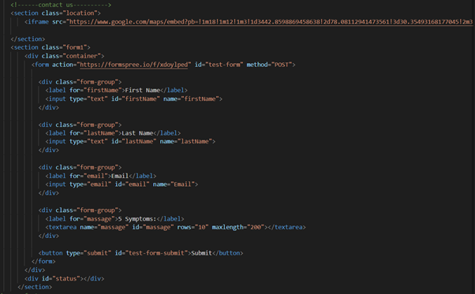
Contact Us page
The action attribute of the form specifies where the form data will be sent when we submit the form.
The “POST” method sends the form data as an HTTP-post transaction, the label tag is used to define labels for different input types and input type is telling us which type of input we need to take in that particular input field i.e. in string format.

Slide 27
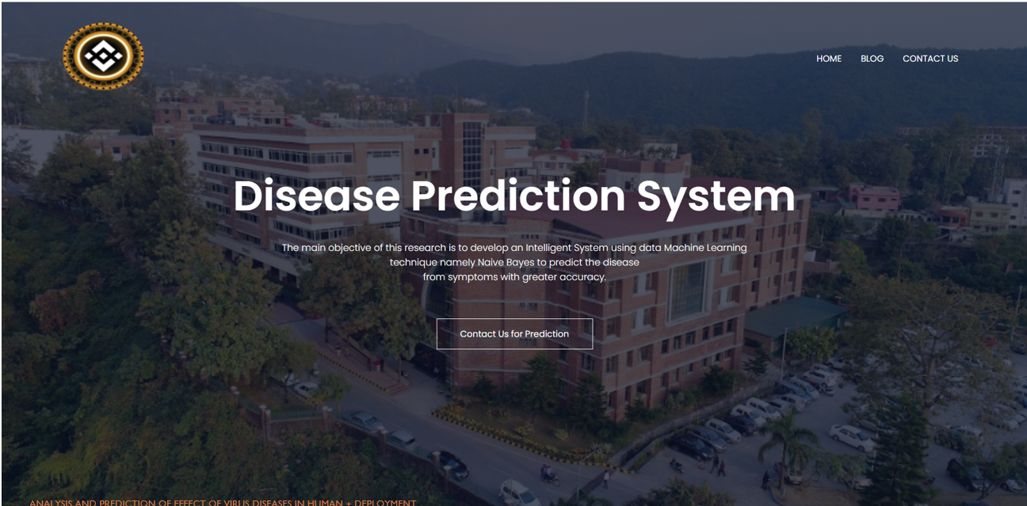

Slide 28
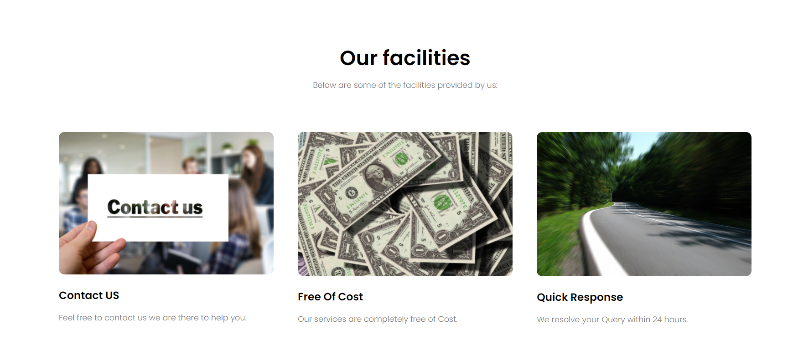

Slide 29

Flask
Flask is an API of Python that allows us to build up web-applications. It was developed by Armin Ronacher.
Flask’s framework is more explicit than Django’s framework and is also easier to learn because it has less base code to implement a simple web-Application.
Flask is based on WSGI(Web Server Gateway Interface) toolkit and Jinja2 template engine.

Slide 30
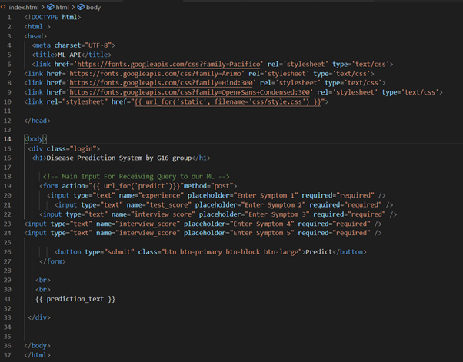
front end part for disease prediction model:
This file will basically act as our front-end web app so that any request that we give to our our model which will be in the form of API which we have hosted through flask it will interact with that, get the output from that particular API itself.

Slide 31
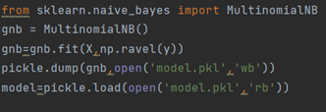
Model.py file
model.py is the model building file i.e. creating our model.
This also involves feature engineering, all the data pre-processing.
After doing a fit our model will be ready after that we have just used pickle.dump this pickle is basically coming from the pickle library so this pickle helps us to create a pre-compile format model name which will just be like a file which will have a extension like “.pkl”.

Slide 32
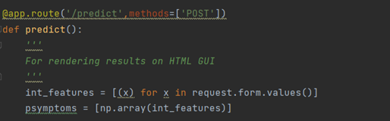
App.py file
When the predict function executes then the five symptoms that we have provided as user input these inputs will be read from the form using request.form.values().
Since it is a post request and after that we have converted these inputs to array and store them in “psymptoms”.
We have used “model.predict” to predict the index of the disease based on the user inputs and if that disease at that index is present in our dataset then we will be displaying that disease in our webpage.

Slide 33
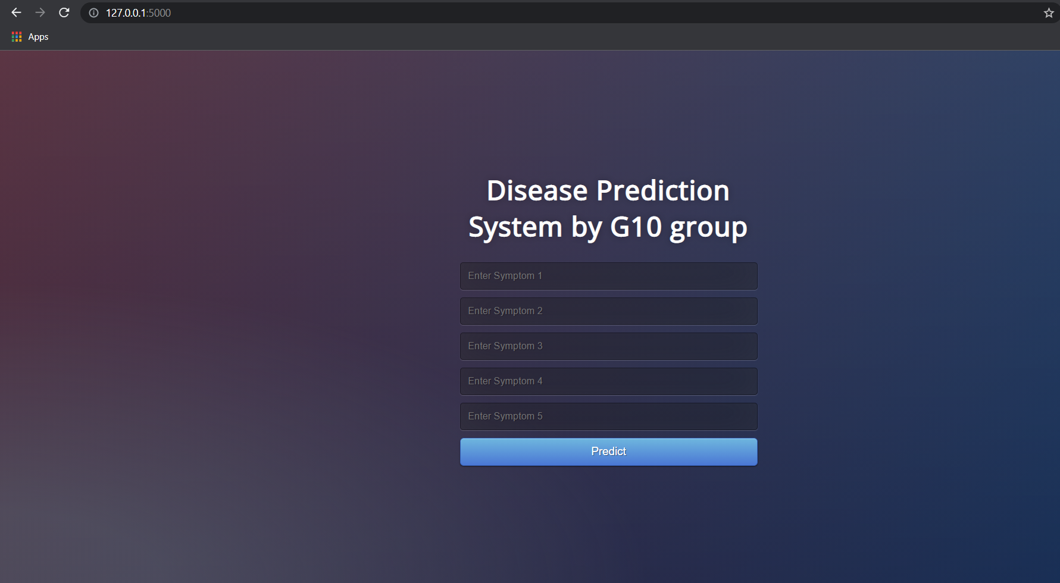
Default View

Slide 34
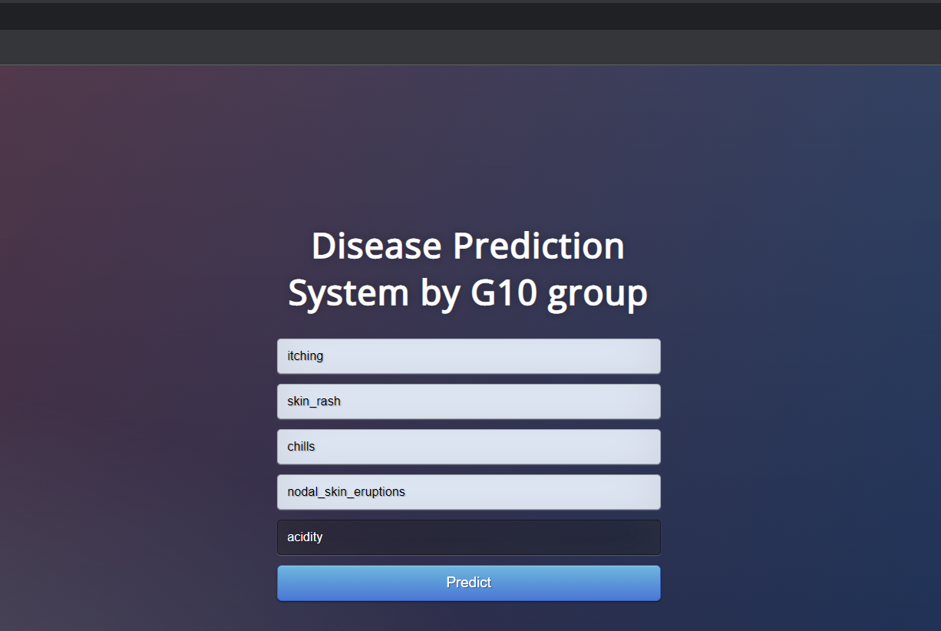
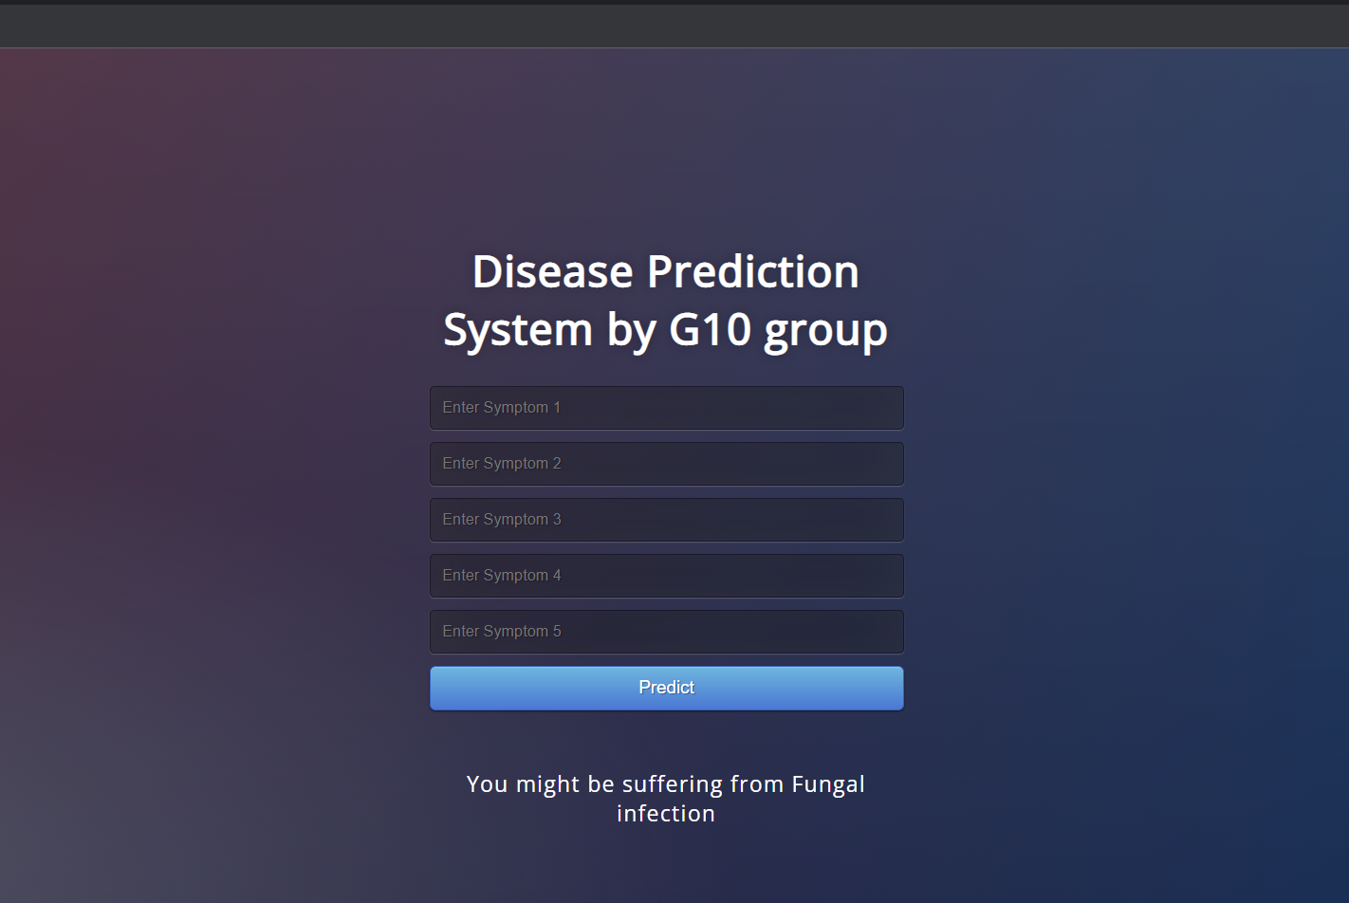
Working flow:
1st step: Enter the symptoms
2nd step: Click on Predict to get the desired results

Slide 35


THANKYOU

